Slide 1
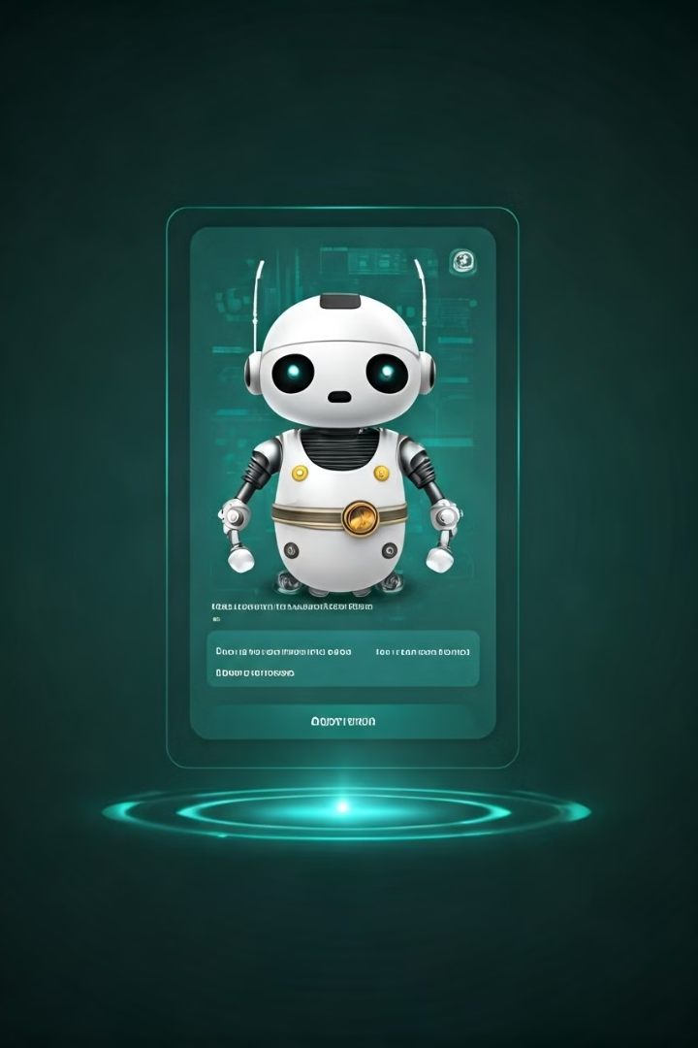

https://landbot.site/v3/H-2656397-3MABBT1QK9TS9G2I/index.html
Quick Travel Planner
Developing a Conversational Agent to Improve Customer Experience
This case study explores the development of "Quick Travel Planner," an innovative chatbot designed to revolutionize travel planning. Created by Pooja Meshram, this AI-powered assistant aims to enhance customer experience in the dynamic travel industry.
by Pooja Meshram
https://landbot.site/v3/H-2656397-3MABBT1QK9TS9G2I/index.html
Notes:
Good morning/afternoon everyone.
Today, I'll be presenting our project on developing a conversational agent, specifically a travel planning chatbot named "Quick Travel Planner."
This chatbot aims to improve customer experience by providing 24/7 automated assistance and personalized travel recommendations.

Slide 2
The Need for Automated Customer Service
Traditional Methods
Chatbot Solution
Customer Satisfaction
Long wait times and inefficient processes lead to customer dissatisfaction. Human agents struggle with high call volumes and repetitive queries.
24/7 automated assistance handles common queries instantly. AI-powered responses ensure consistent, accurate information delivery to customers.
Immediate responses and personalized interactions improve overall customer experience. Chatbots free human agents to focus on complex issues.
Notes:
Traditional customer service methods often fall short in providing timely and personalized assistance.
Our chatbot, "Quick Travel Planner," is designed to address these limitations by offering automated support and enhancing the overall customer experience.

Slide 3

Opportunity Analysis in Travel Planning
1
Identifying Pain Points
Surveys and feedback analysis revealed common customer frustrations. Long response times and inconsistent information were primary concerns.
2
Defining the Scope
Travel planning emerged as a high-impact domain for chatbot implementation. The focus shifted to creating an AI assistant for this niche.
3
Feature Prioritization
Key features like destination recommendations and itinerary planning were identified. These aligned with customer needs and interest .
Notes:
Common issues identified included: Long wait times for assistance
Difficulty finding relevant travel information
Need for personalized recommendations
These insights guided the development of chatbot's features and functionalities.

Slide 4





Capability Mapping for Quick Travel Planner
Natural Language Processing
External System Integration
Advanced NLP algorithms enable human-like understanding of diverse user queries. Context awareness improves response accuracy.
Real-time data from travel APIs ensures up-to-date information. ChatGPT integration enhances conversational abilities.
Personalization and Data Collection
Human Handoff
Seamless transfer to human agents for complex queries. Ensures comprehensive customer support for all scenarios.
User preferences drive tailored recommendations. Automatic lead collection facilitates future marketing efforts.
Notes:
Our chatbot is equipped with the following capabilities:
Natural Language Processing: Understands and responds to a wide range of user queries.
Integration with External APIs: Accesses real-time data from travel providers to offer accurate and up-to-date information.
Personalized Recommendations: Tailors suggestions based on user preferences and past behavior.
Seamless Handoff: Transfers complex queries to human agents for specialized assistance.

Slide 5




Conversation Design Process
User Journey Mapping
Dialog Flow Design
Testing and Refinement
Created visual representations of customer interactions. Identified key touchpoints for chatbot intervention.
Structured logical conversation paths. Ensured natural, intuitive progression through travel planning stages.
(Travel dates
Budget
Interests)
Conducted iterative testing to identify gaps. Refined dialog flows based on user feedback and interaction data.
Notes:
We designed a user-friendly and intuitive conversation flow.
The chatbot guides users through a series of questions, such as: Preferred destination
Travel dates
Budget
Interests
Based on the user's input, the chatbot provides tailored recommendations for flights, hotels, and activities.

Slide 6
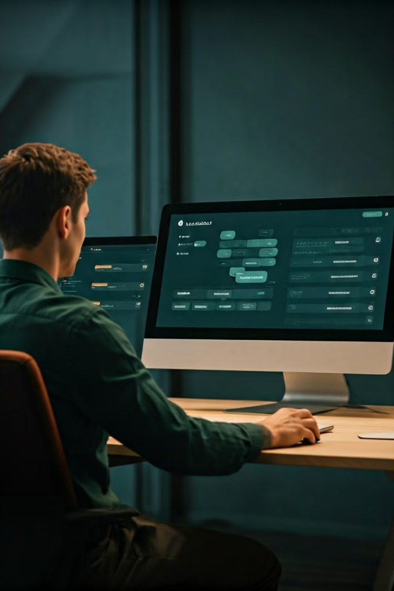
Building with Landbot Platform
1
User-Friendly Interface
2
Drag-and-Drop Functionality
Landbot's intuitive design simplified the chatbot creation process. Non-technical team members could contribute effectively to development.
Rapid prototyping was achieved using pre-built blocks. Custom components allowed for unique features tailored to travel planning.
3
API Integration
4
Continuous Improvement
Seamless connection to travel data sources enhanced chatbot capabilities. Real-time information on weather, hotels, and attractions improved user experience.
Ongoing testing and refinement ensured optimal performance. User feedback drove iterative updates to the chatbot's functionality.
Notes:
Speaking Notes: We utilized Landbot's drag-and-drop interface to create the chatbot's conversation flow.
Key features of Landbot that we leveraged:
Pre-built templates
Integration with external APIs
Analytics and reporting tools
This allowed us to quickly and efficiently develop the chatbot.

Slide 7
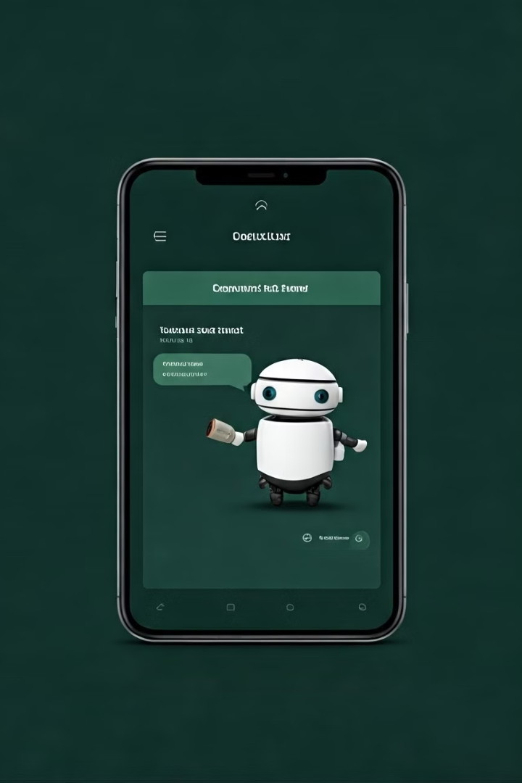
User Testing and Evaluation
Phase
Activities
Outcomes
Recruitment
Selected diverse user profiles
Comprehensive representation of target audience
Task-Based Testing
Assigned specific travel location planning scenarios
Identified strengths and weaknesses in chatbot performance
Feedback Collection
Gathered qualitative and quantitative data
Insights on user satisfaction and areas for improvement
Refinement
Implemented user-suggested changes
Enhanced chatbot accuracy and user experience
Notes:
User Testing: We conducted user tests to gather feedback on the chatbot's performance and user experience. Key areas of focus:
Ease of use
Accuracy of information
Overall satisfaction
Iterative Refinement: We used the insights from user testing to make improvements to the chatbot's responses, logic, and user interface.

Slide 8

Conclusion and Future Directions
Achieved Objectives
Future Enhancements
Successfully developed an effective travel planning chatbot. Improved customer satisfaction and query resolution times.
Explore advanced AI integration for more natural conversations. Implement multi-language support and voice interaction capabilities.
Key Lessons
Industry Impact
Emphasized importance of user research and iterative development. Continuous improvement is crucial for long-term chatbot success.
Set new standards for automated customer service in travel. Demonstrated potential of AI in enhancing customer experiences.
Notes:
Key Achievements: Developed a functional chatbot capable of handling complex travel queries.
Improved customer satisfaction and reduced response times.
Gained valuable insights into chatbot development and user experience.
Future Directions: Explore advanced features like sentiment analysis and voice recognition.
Expand the chatbot's capabilities to include additional travel services, such as visa assistance and travel insurance.
Continuously monitor and refine the chatbot's performance based on user feedback and evolving technology.

Slide 9
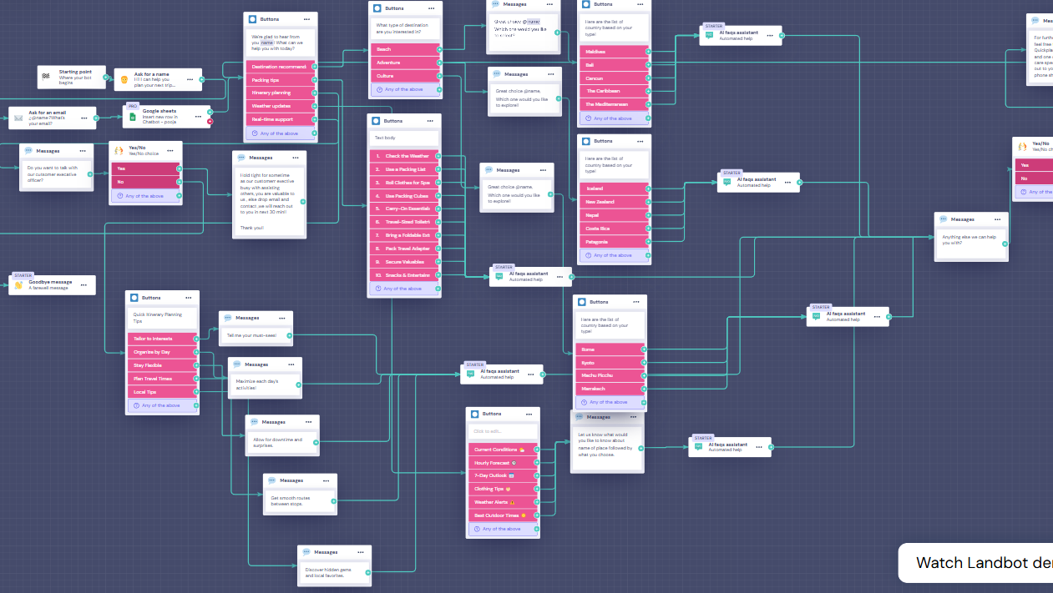

Slide 10

Thank You!!

